Slide 1
Session 8

Slide 2
Terminal Objectives
At the end of this session, you will be able to qualify, import, and convert bitmap images into clean, machinable vectors using Vectric’s built-in tracing and editing tools.

Slide 3
Enabling Objectives
Identify the differences between Vector and Raster images.
Identify key features in images that are required for CNC machining.
Import bitmap images (.jpeg, .png, etc.) into the Vectric environment.
Utilize the “Trace Bitmap” tool to convert images into vector files.
Clean up and edit traced vectors using the appropriate tools.

Slide 4
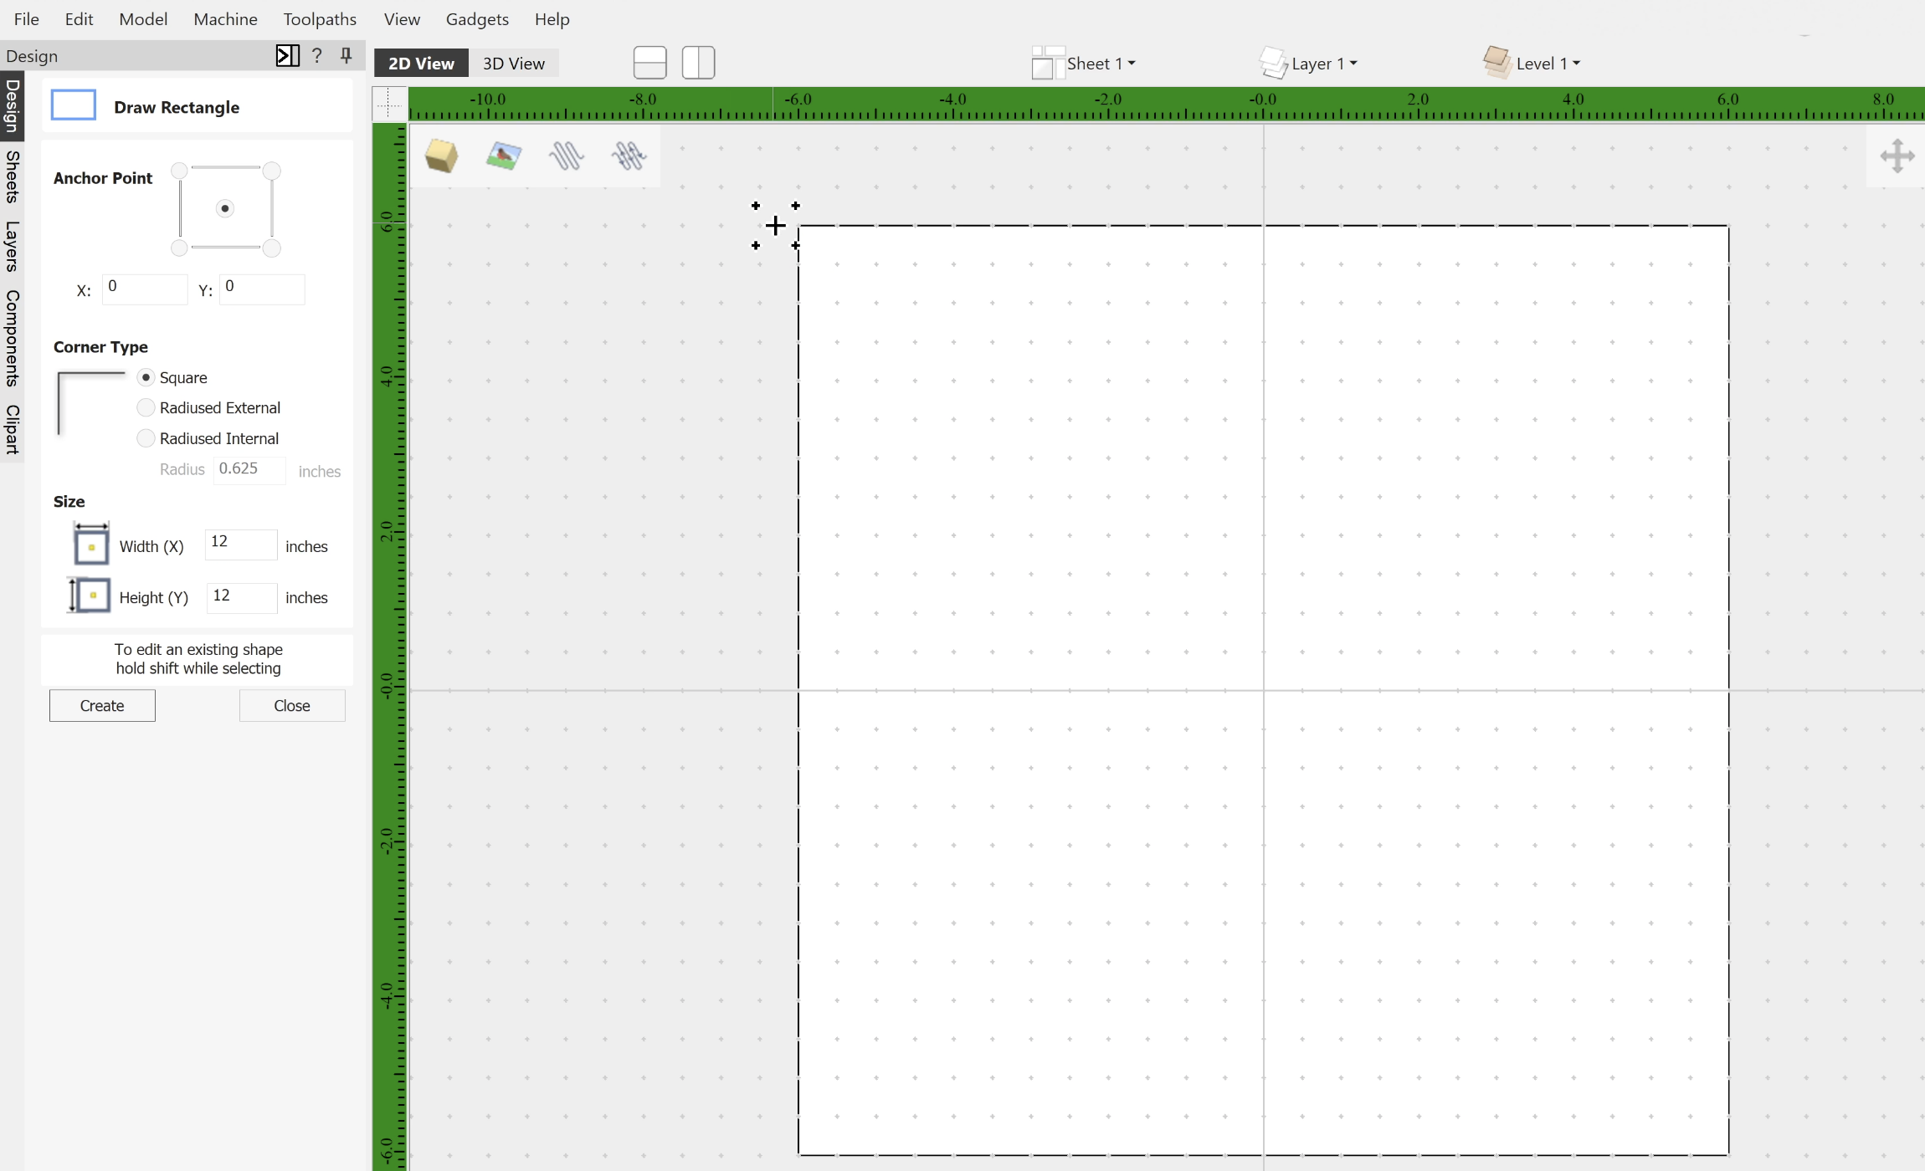
Boundary Vector
At the beginning of each project, we are going to create a Boundary Vector that is the exact dimensions of your workspace.
Even though we haven’t learned WHY yet, we are about to!

Slide 5
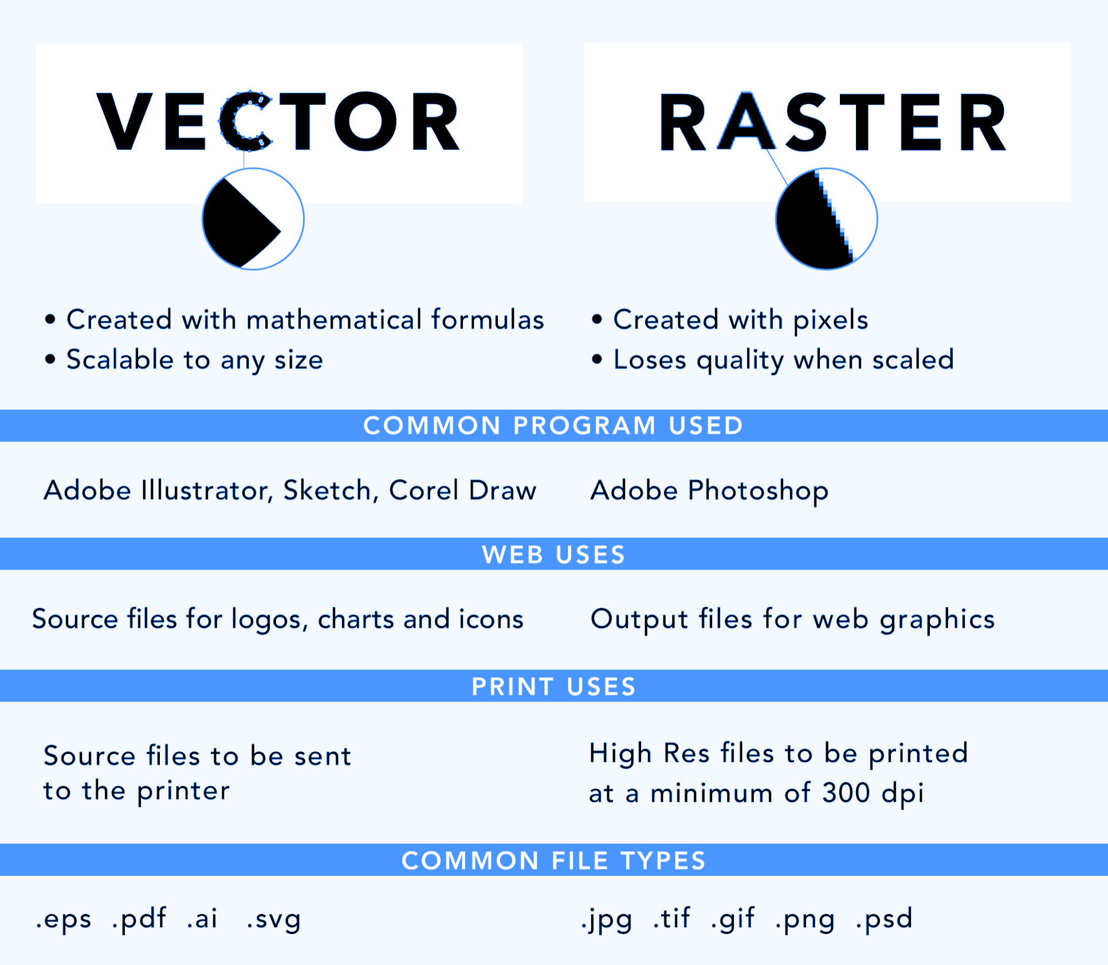
Vector vs. Raster Images
Vector Images: Made from mathematical paths - lines, curves, and shapes defined by coordinates. This means they can be scaled infinitely without losing quality. They are ideal for CNC work, though can be difficult to find.
Raster Images: Made of pixels - tiny squares of color. They’re great for photos but become blurry or pixelated when scaled up.

Slide 6
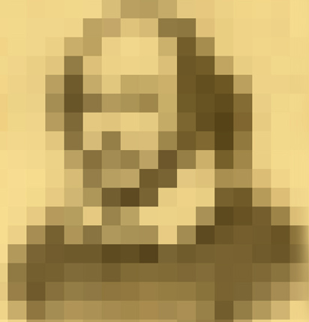
Finding Raster Images
When looking for bitmap images to convert into vectors, you want clean, high-contrast graphics - ideally black and white. Here’s what to look for:
High Contrast: The best results come from images with sharp differences between light and dark areas. A black logo on a white background is ideal.
Simple Shapes: Avoid photos or images with gradients, shadows, or lots of fine detail. Vector conversion works best with bold, clean lines.
High Resolution: A low-resolution image may look pixelated or blurry, leading to messy vectors. Aim for images that are at least 300 DPI.
Minimal Noise: Avoid images with background clutter or texture. Extra “noise” in the image will create extra vectors you don’t want.
Bottom line: Think logos, clipart, and icons, not photographs or detailed artwork. Simpler is better when it comes to clean vector conversion.

Slide 7
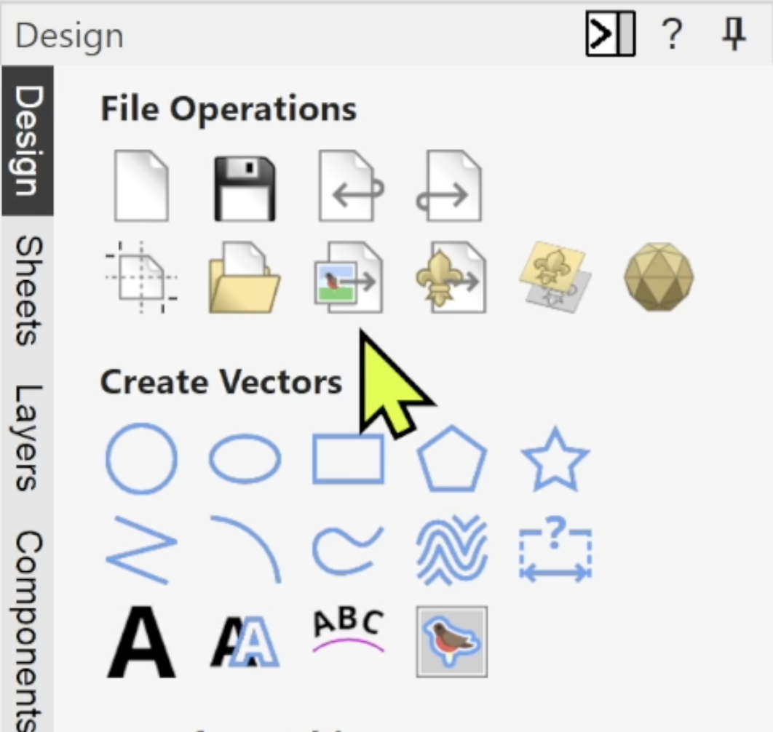
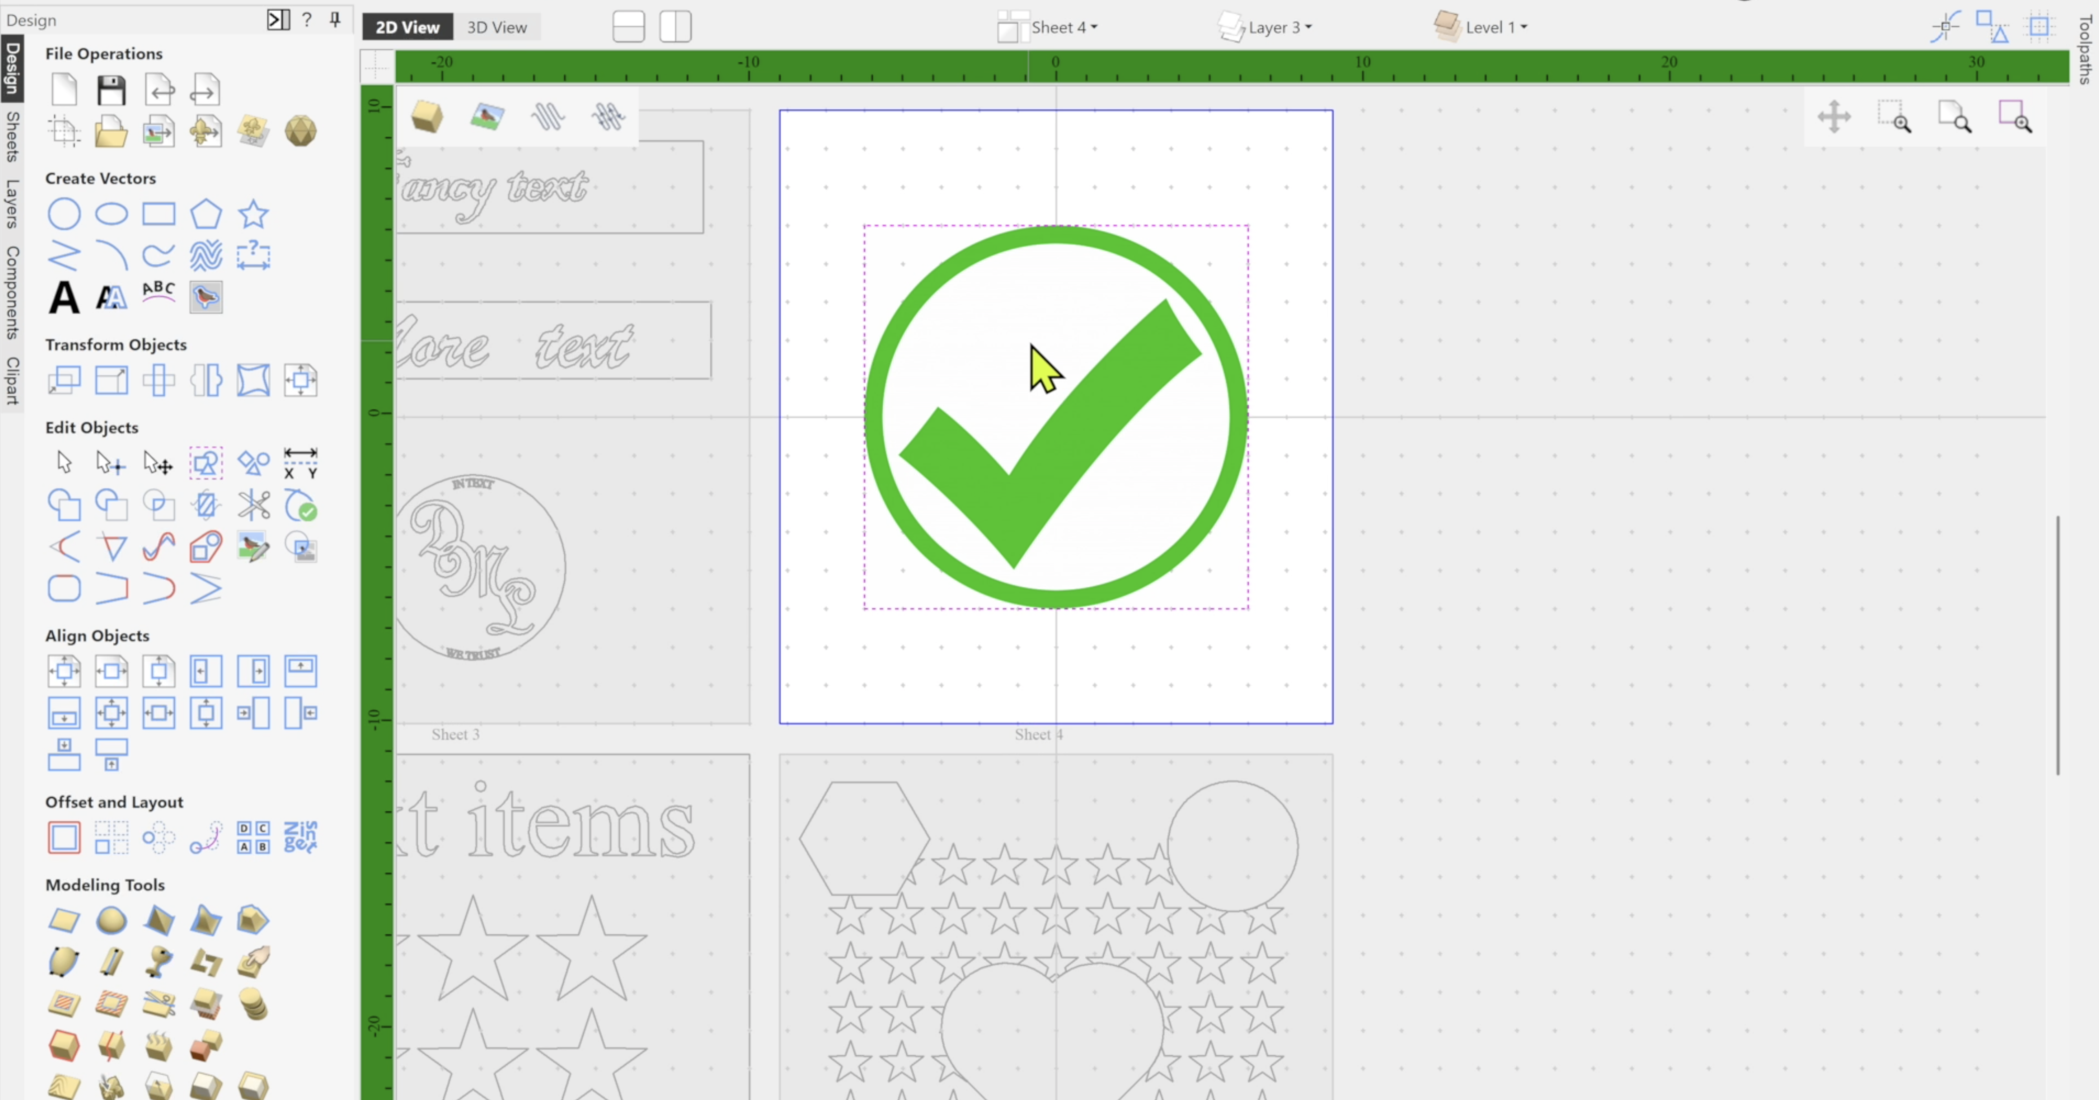
Importing Bitmaps
Any time that you see a bird icon in the Vectric environment, it is related to bitmap images.
Bitmap images can be imported using the Import A Bitmap operation, or by simply dragging and dropping into the software, although we recommend saving the image onto your computer and then manually importing it.
Remember that bitmaps can never be machined, only vectors can be!

Slide 8
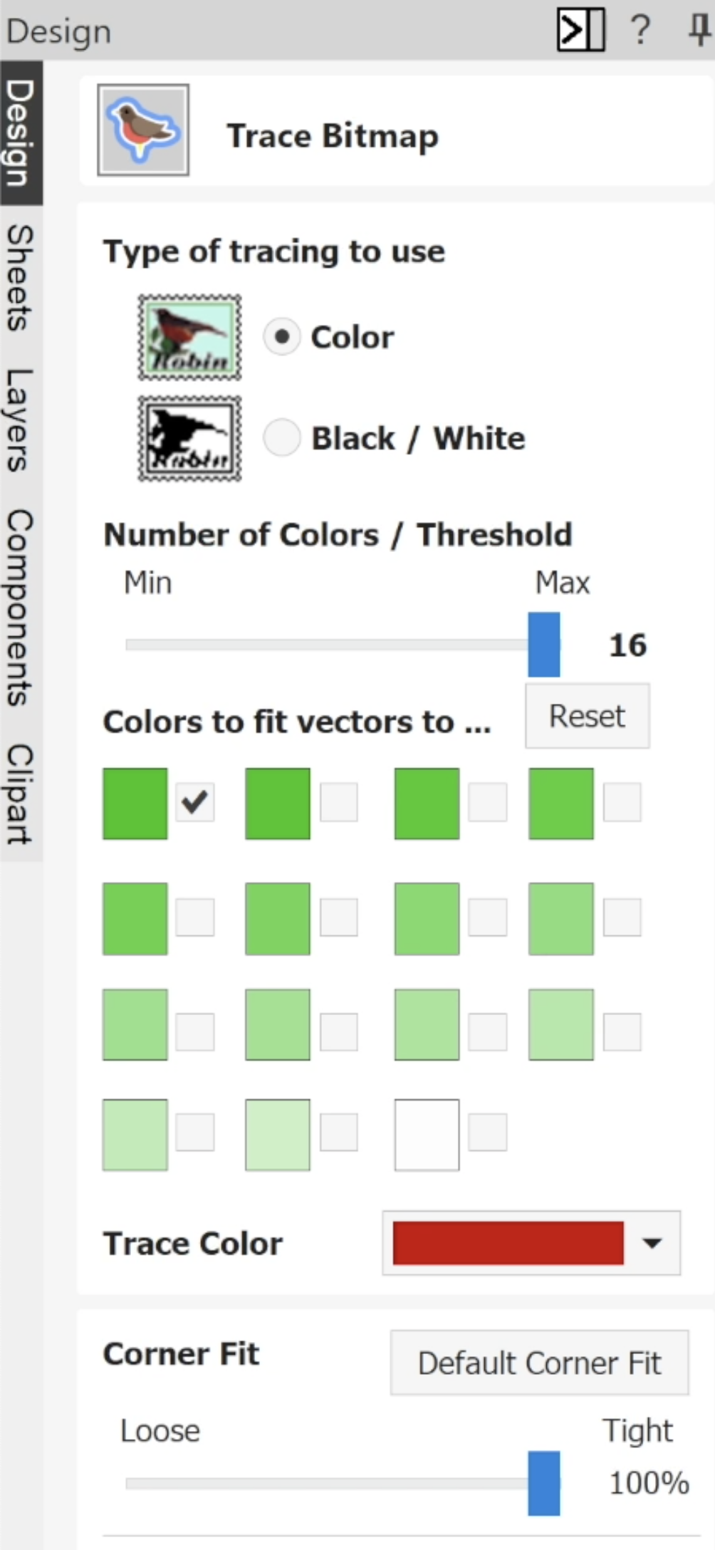
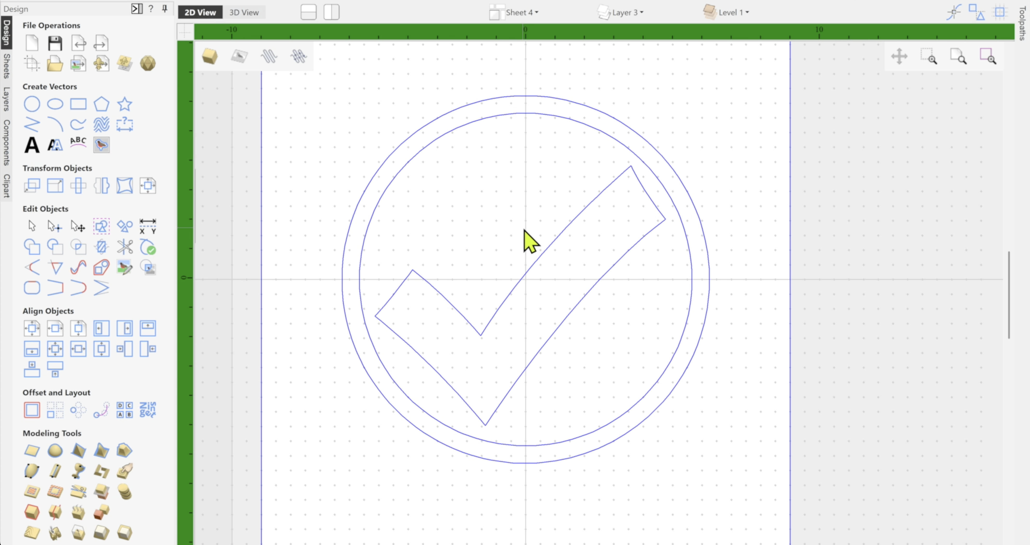
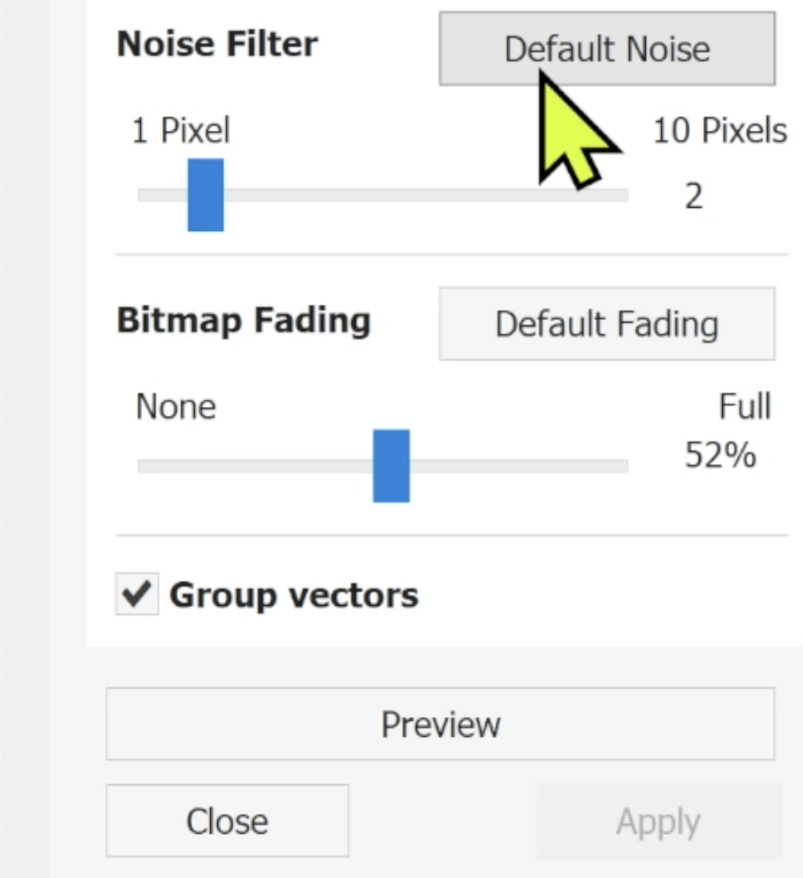
Tracing Bitmaps
Tracing using Color is useful when trying to manually select multiple colors in your image.
When possible, trace using Black / White to simplify the process. Adjust the threshold as needed to create clean vectors.
Adjust Noise Filter to remove small, unnecessary pixels.
Make necessary adjustments and use the Preview option until you are satisfied with the results. Click Apply to finalize your tracing.

Slide 9
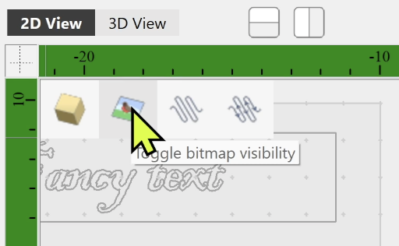
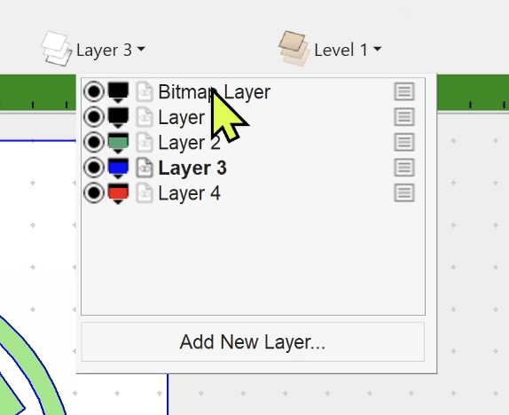
Bitmap Visibility
Once a bitmap is traced, the original image is no longer necessary, but it is available for reference.
Use the Toggle Bitmap Visibility button to view or hide the bitmap.
A new layer is also created specifically for bitmap images, which can be toggles on or off.

Slide 10
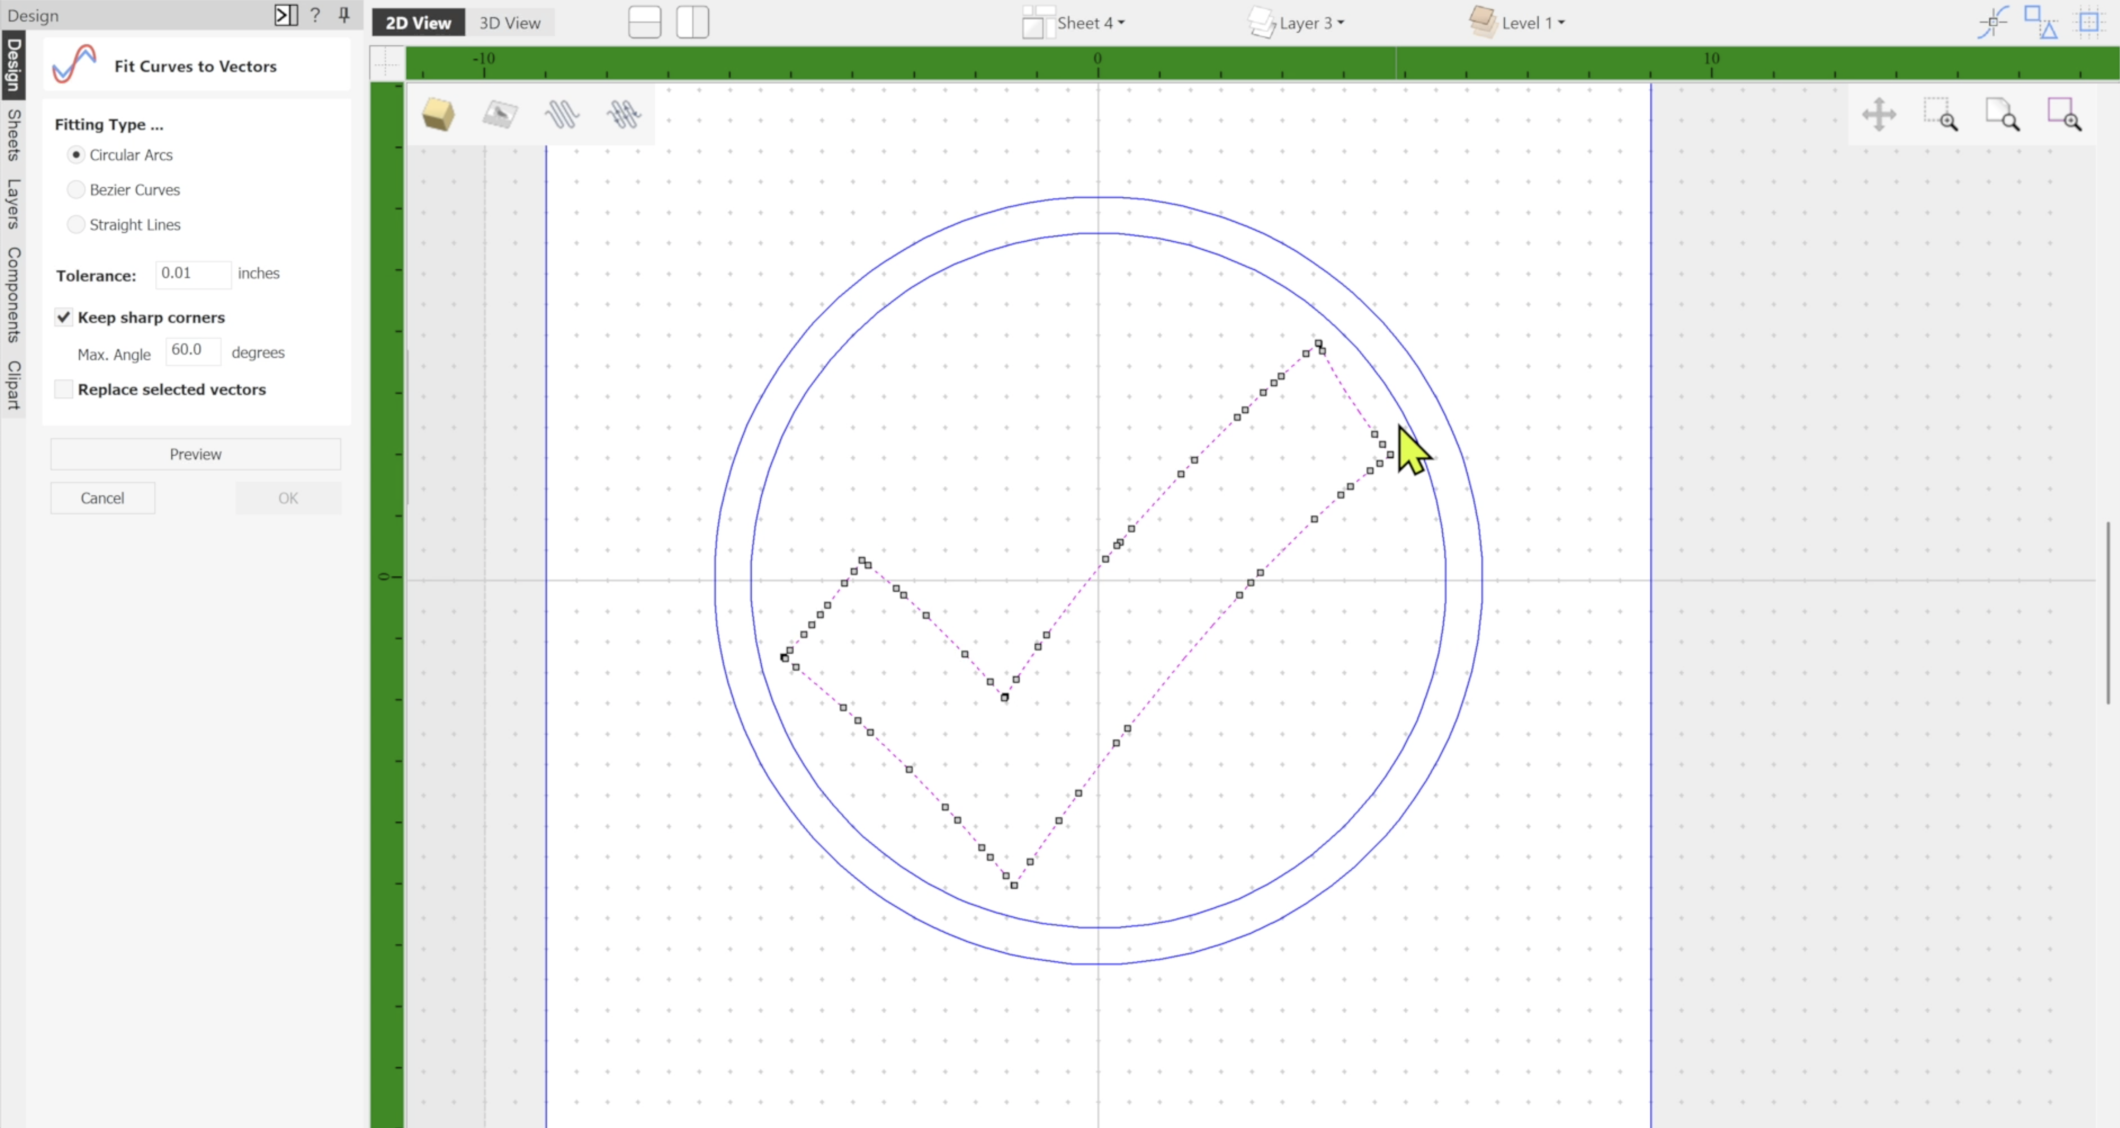
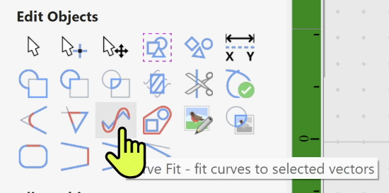
Vector Cleanup
Traced bitmaps can often result in unneeded or messy nodes, which may require us to clean them up for proper machining.
Node editing can only be done on Ungrouped vectors.
The Curve Fit feature can be used to create smooth arcs, curves or lines to eliminate nodes.

Slide 11
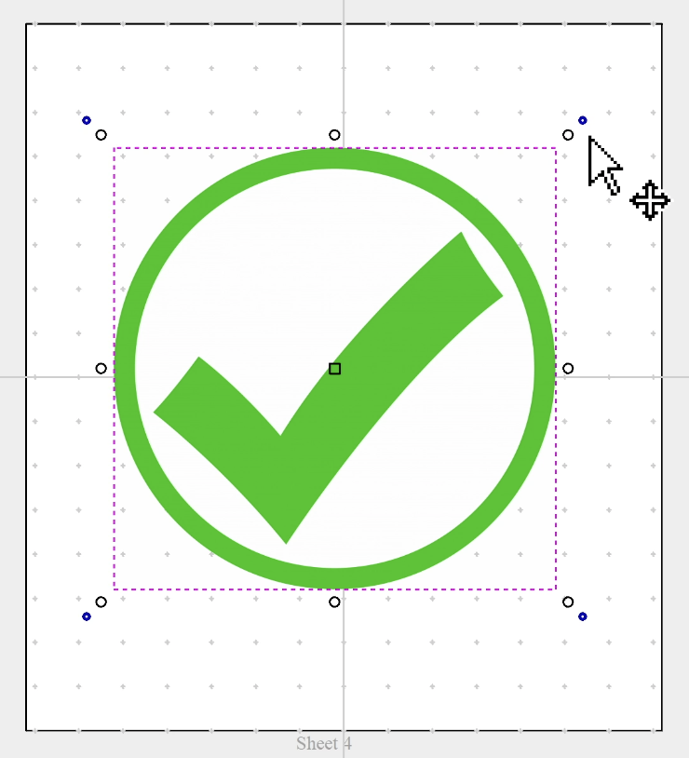
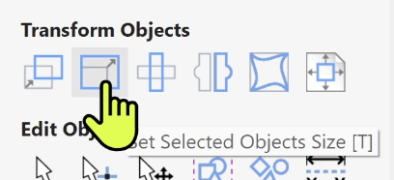
Transforming Objects
When an object is selected, you can simply click a second time to enable moving, scaling, rotating, and other features.
Blue handles are for rotation.
Clear handles are for scaling.
You can also use the Transform Objects icons to modify your objects.

Slide 12
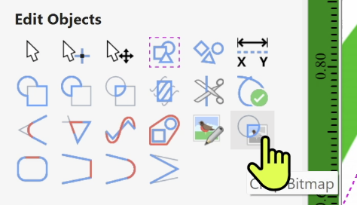
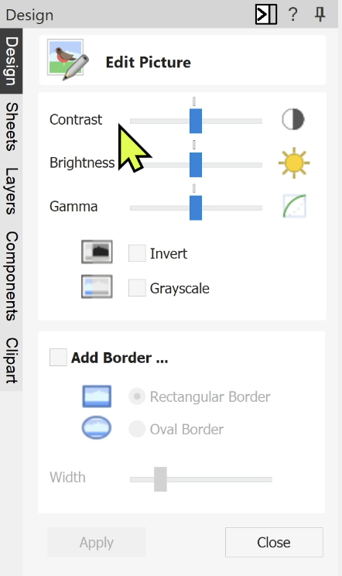

Editing Bitmaps
Vectric has some very basic tools to edit bitmaps prior to tracing them.
Picture Editor allows you to adjust Contrast, Brightness, Gamma, and Colors.
Crop Bitmap allows you to crop a portion of the bitmap based on the boundary of a selected vector.

Slide 13

Trademarks
Students should avoid using trademarked, copywrite or registered images on their CNC projects. Doing so can violate copyright or trademark laws, even in a school setting. Unless permission is granted, using protected logos or designs could result in legal issues and teaches poor respect for intellectual property.
When possible, look for royalty-free artwork.

Slide 14
Session 8 Summary

