Slide 1
Session 2

Slide 2
Terminal Objectives
At the end of this session, you will be able to navigate the Vectric software environment, understand the differences between VCarve Desktop, VCarve Pro, and Aspire, and properly configure your default settings, material setup, machine configuration, and tool database.
lesson guide // session 2

Slide 3
Enabling Objectives
Identify the key differences between VCarve Desktop, VCarve Pro, and Aspire.
Restore Vectric software to its default settings.
Configure material setup parameters, including size, thickness, and Z-zero position.
Adjust machine configuration settings appropriate to your specific CNC machine.
Access and edit the Tool Database, including adding, modifying, and selecting tools.
Understand the significance of each setting in ensuring accurate and safe machining.
Learn how to upload and download databases from the cloud.
lesson guide // session 2

Slide 4



Welcome to the
Vectric Environment
The Vectric Environment refers to the entire user interface and ecosystem within Vectric software - whether you're using VCarve Desktop, VCarve Pro, or Aspire. It includes all the tools, settings, and views you interact with when designing and preparing files for CNC machining.
  VCarve Desktop is ideal for hobbyists, with a 25" x 25" size limit and core 2D and 2.5D toolpath features.
  VCarve Pro removes the size restriction and adds features like nesting, tiling, and rotary axis support, making it suitable for business and educational environments.
  Aspire includes everything in VCarve Pro plus full 3D modelling capabilities, allowing users to create and machine their own 3D designs from scratch.
Notes:
.

Slide 5
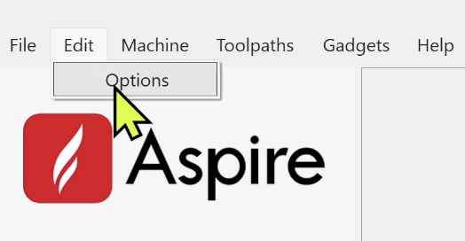
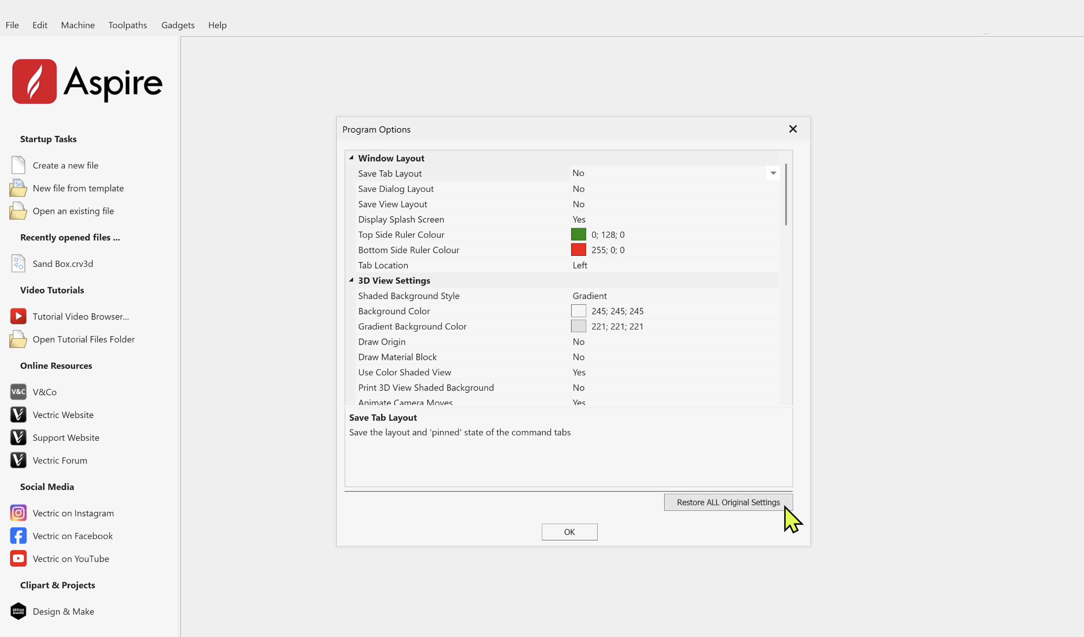
Restoring Settings
The Restore ALL Original Settings. feature in Vectric is a safety net - like a factory reset button for your software.
It is beneficial for fixing misconfigurations and troubleshooting glitches.

Slide 6
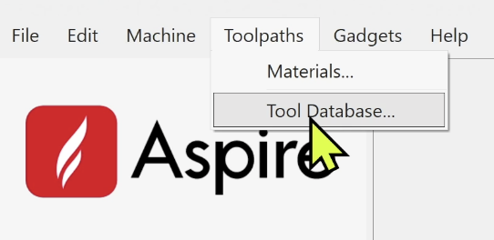
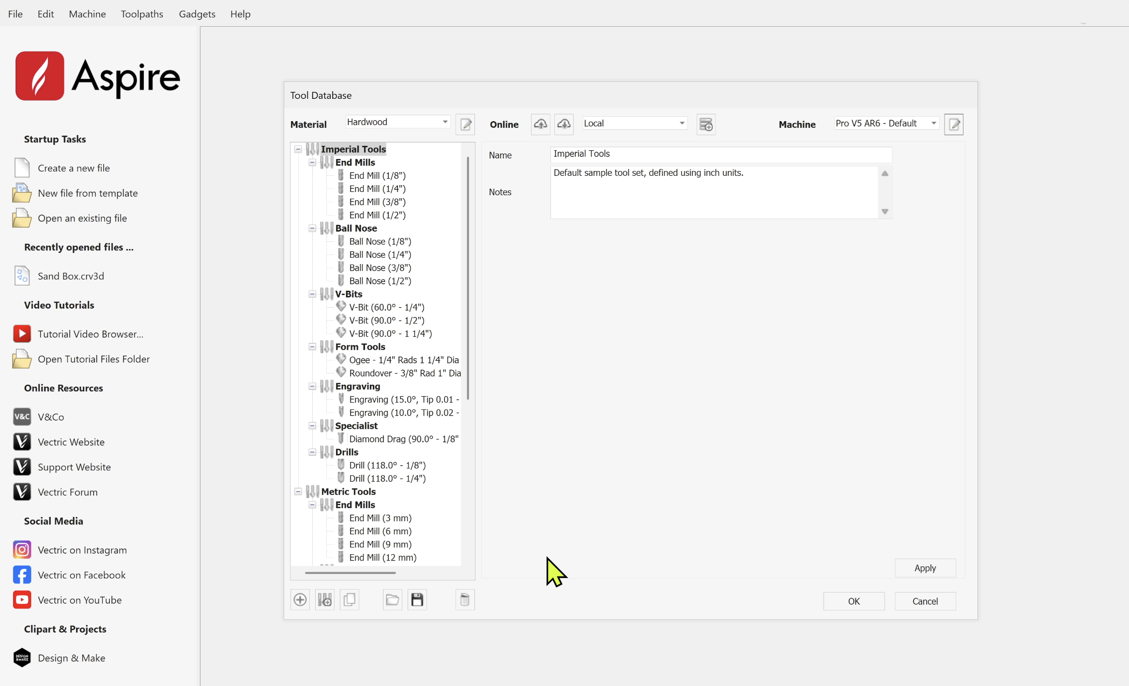
Material Management
The Material Management menu in Vectric software allows you to create, organize, and save preset material settings for various project types.
It can create confusion and the potential for human error, so it is recommended that you only have one Material in your settings to begin (Hardwood).

Slide 7
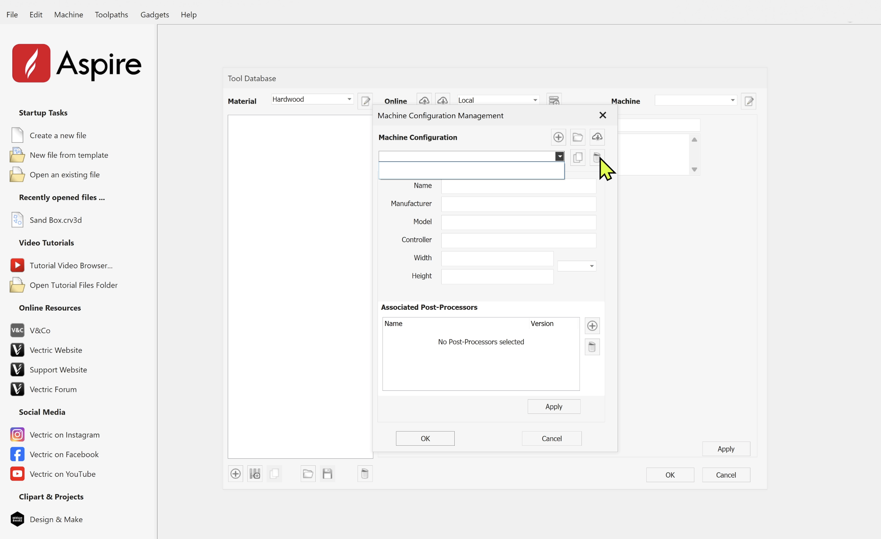
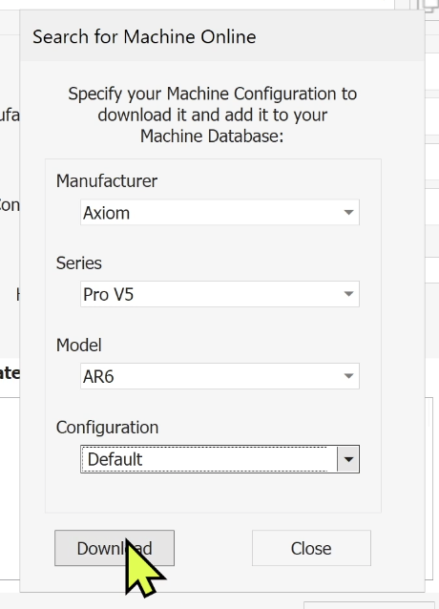
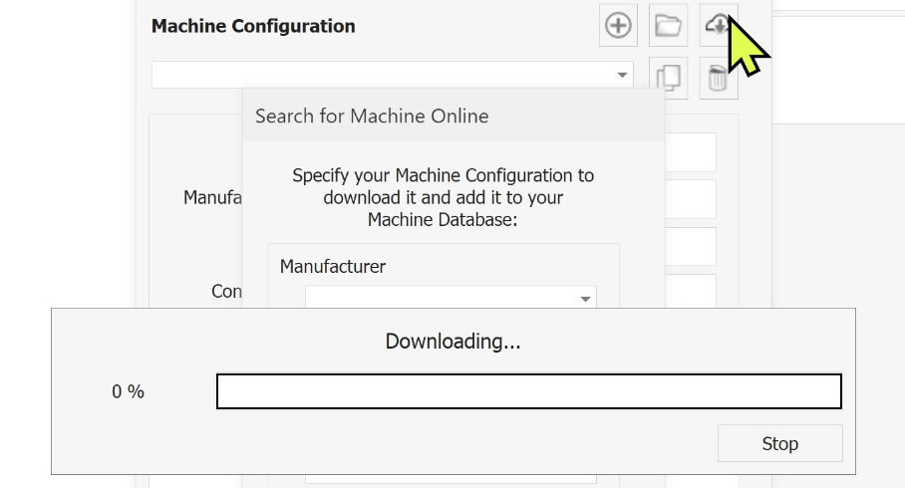
Machine Configuration
By default, the software will come with several Machine Configurations. It is highly recommended that you delete all of them, and only install the machine that you will be utilizing in your woodshop.

Slide 8
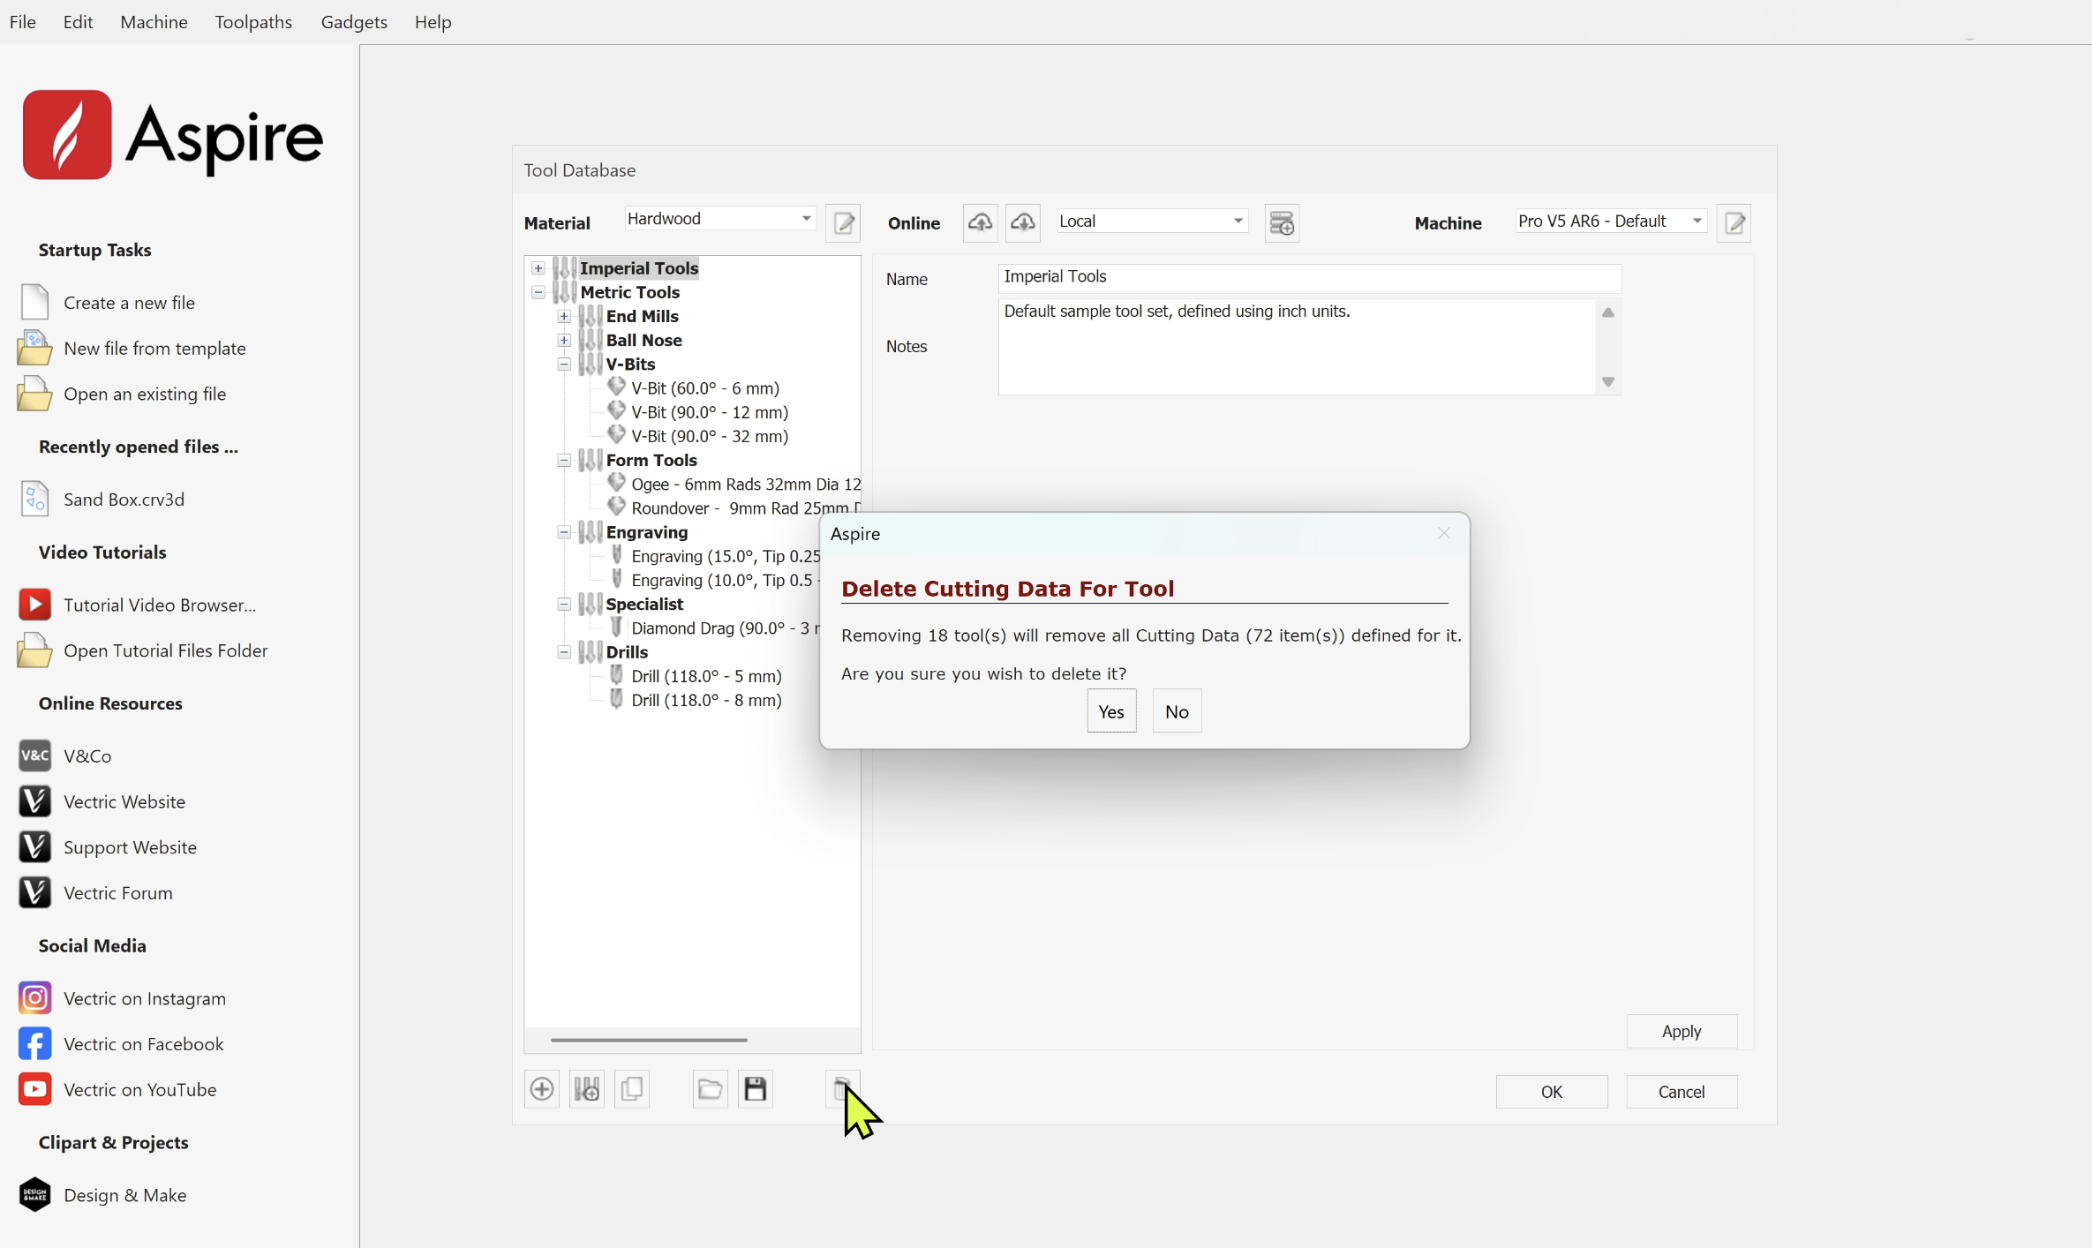
Delete Tool Databases
By default, the software will come with several Tool Databases installed. It is highly recommended that you delete all of them, and only install the tools that you will be utilizing in your woodshop.

Slide 9
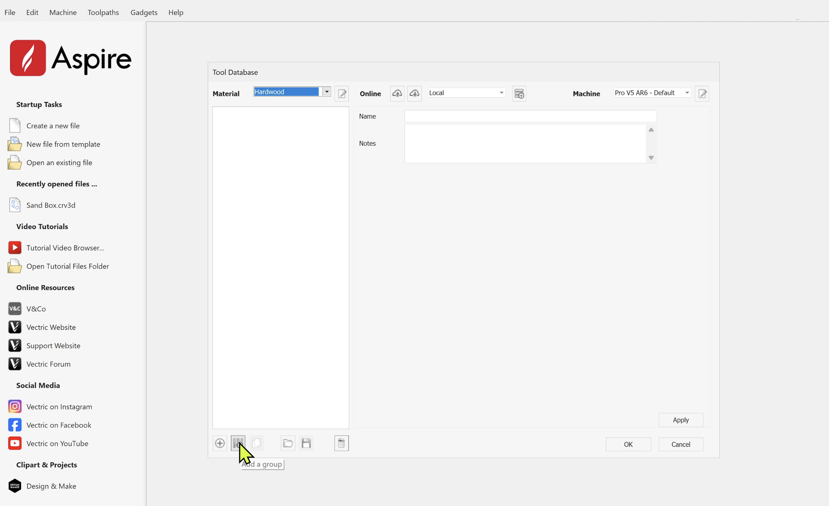
Create Tool Groups
Add A Group to your Hardwood database, and begin creating your tool groups and subgroups based on the tools that you have available.

Slide 10
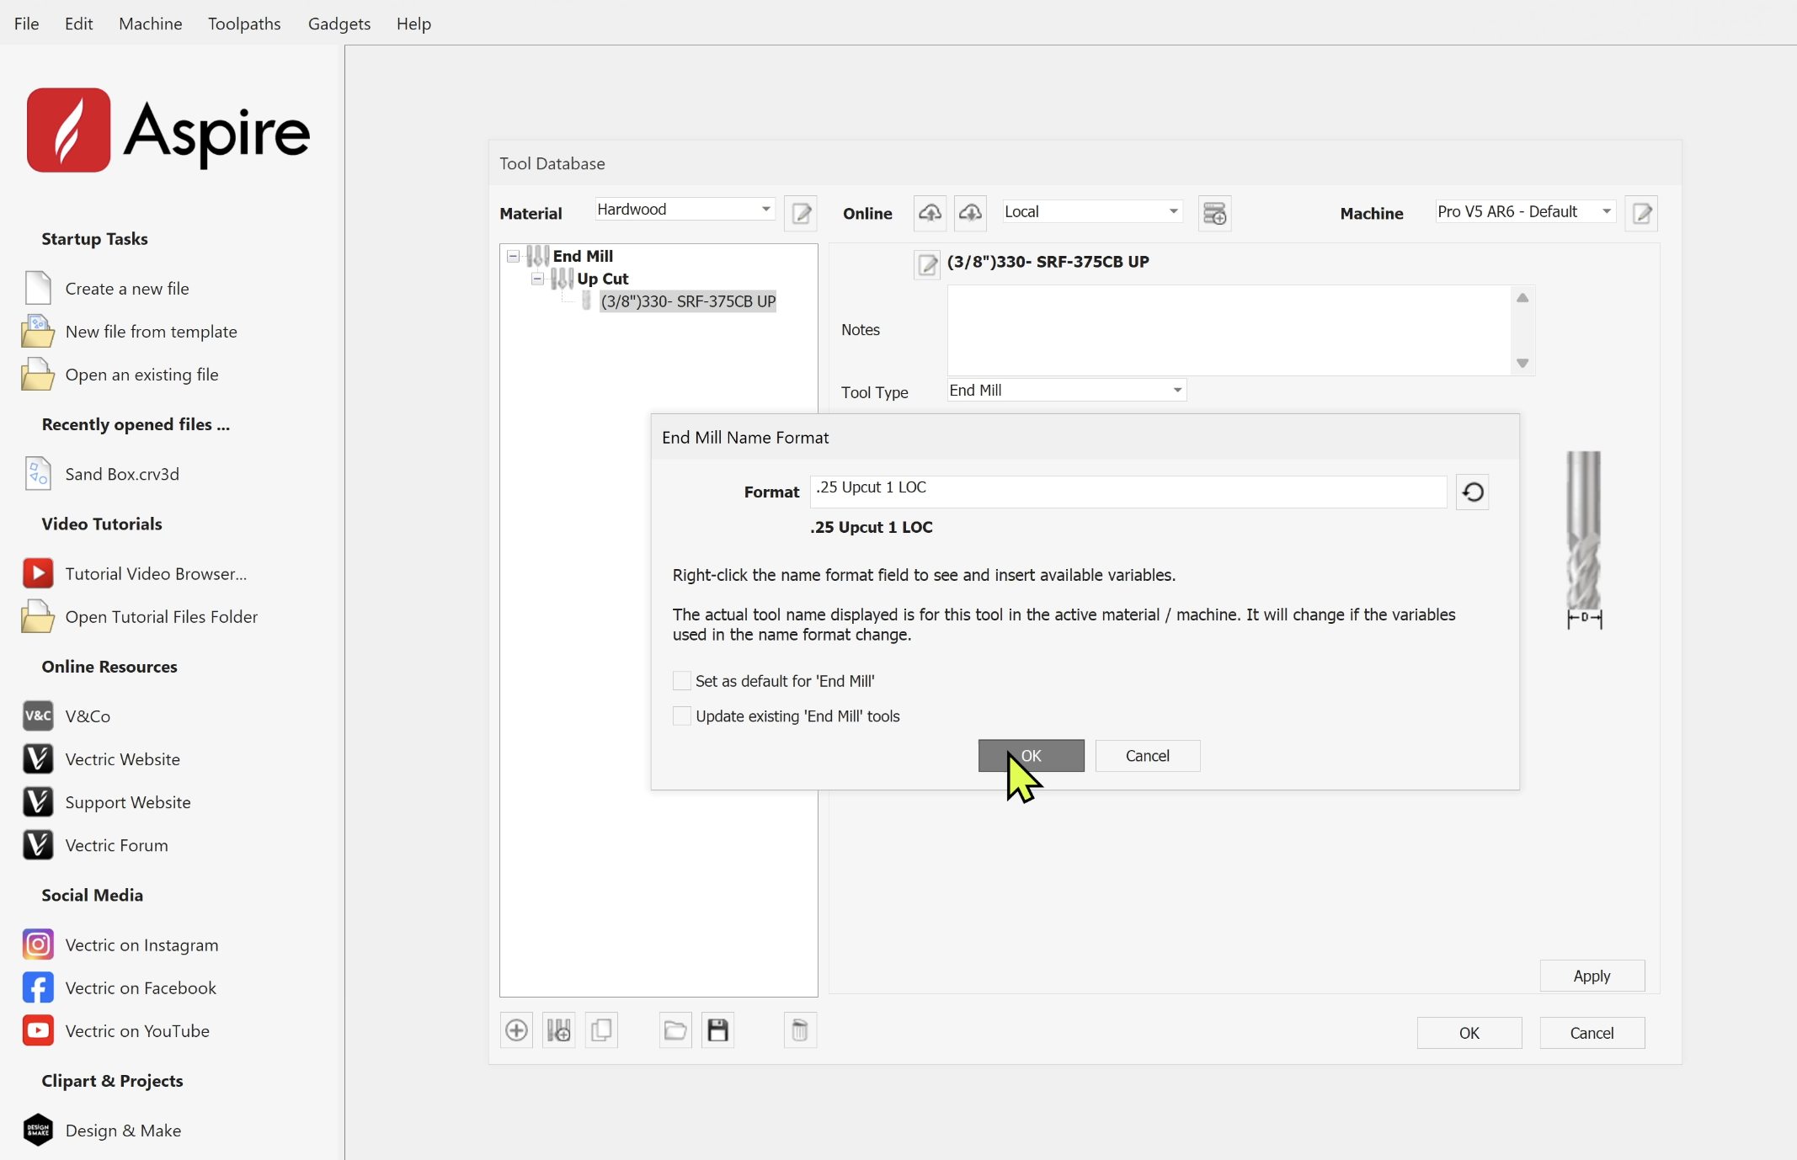
Create Tools
Add A Group to your Hardwood database, and begin creating your tool groups and subgroups based on the tools that you have available.
Start by selecting the Tool Type, followed by the Name Format of your tool.
Uncheck Set As Default For…

Slide 11
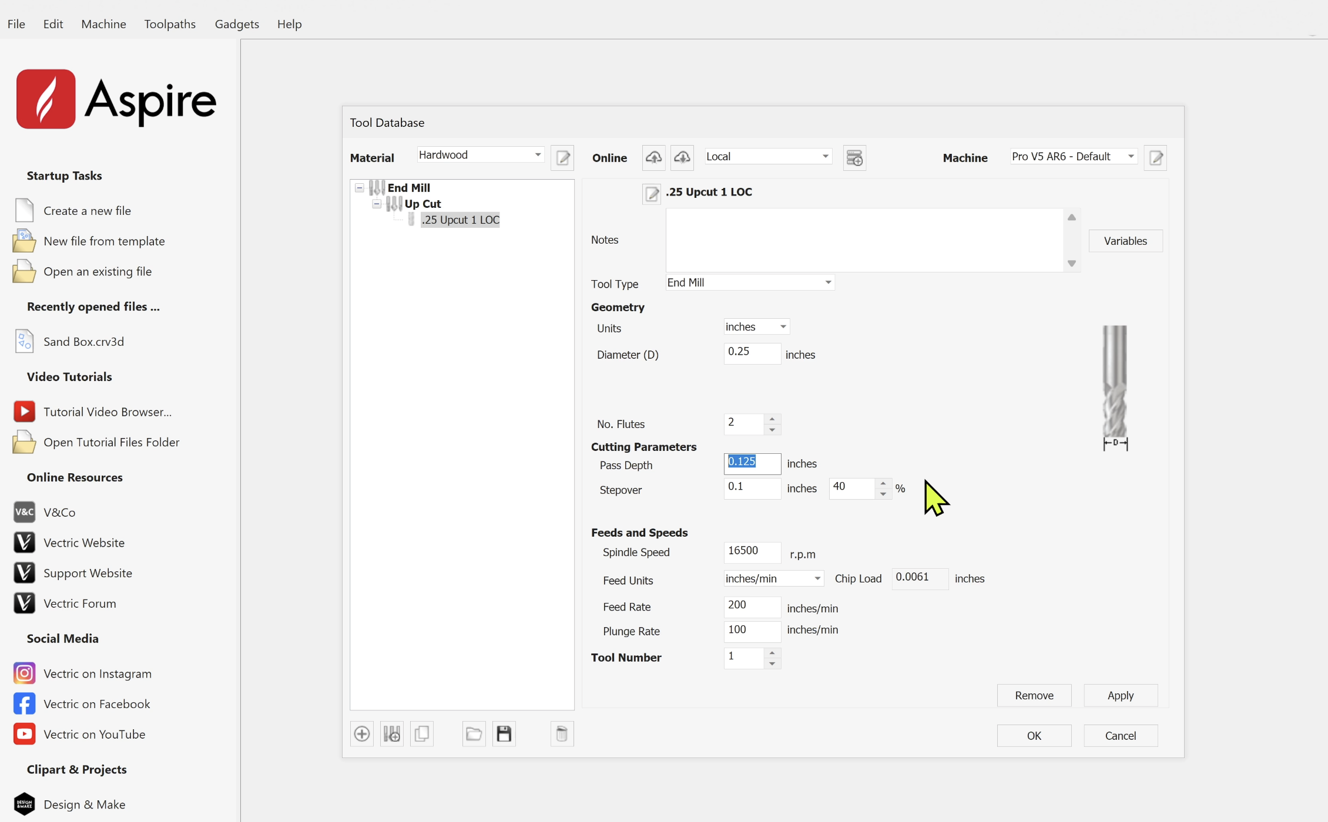
Create Tool Settings
Diameter (D): The width of the tool’s cutting surface.
No. Flutes: The number of cutting edges on the tool.
Pass Depth: The maximum depth the tool can cut in a single pass.
Stepover: The percentage of the tool’s diameter that is overlapped in side-to-side movement.
Spindle Speed: The speed at which the tool spins, measured in revolutions per minute.
Feed Rate: How fast the tool moves through the material in X and Y directions (inches or mm per minute).
Plunge Rate: The speed at which the tool enters the material in the Z direction.

Slide 12

Feeds and Speeds
If you're feeling overwhelmed by CNC feeds and speeds, you're not alone, and you're not doing anything wrong by being cautious. The good news? You don’t need to be a machinist or mathematician to get started:
Use the recommended settings from the tool manufacturer as a baseline.
Stick with common materials like MDF or pine while learning - they are forgiving.
Use conservative settings at first (slower feed rate, shallower pass depth) and adjust as your confidence grows.
Most importantly: listen to your machine. If it sounds rough or is struggling, stop and tweak the numbers.

Slide 13
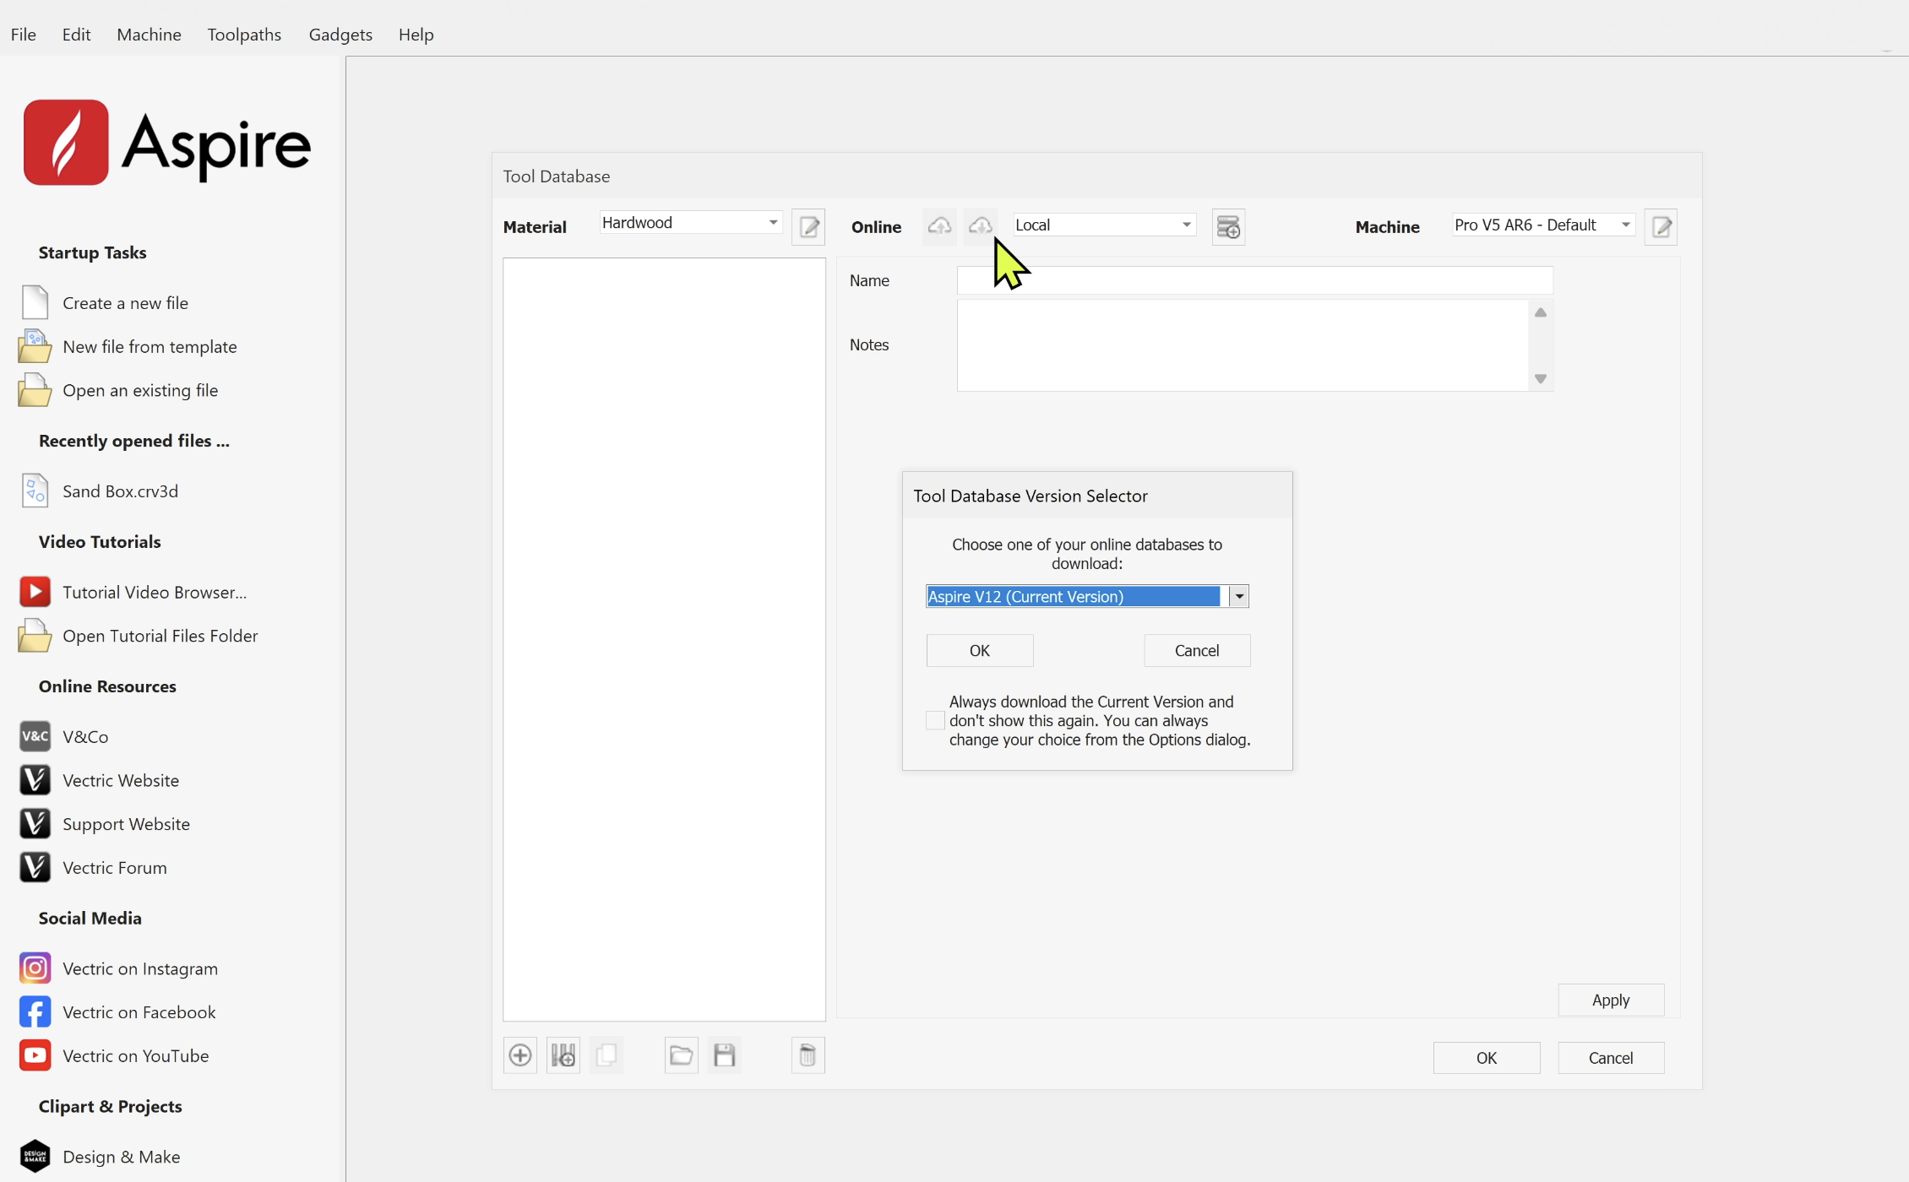
Cloud Tool Database
The Cloud Tool Database in Vectric allows users to store and access a shared library of tools from any computer that’s signed into the same V&Co account. For schools, this is incredibly valuable, as it ensures that every student and teacher is working from the same set of approved tools and cutting parameters, no matter which machine or workstation they’re using. This simplifies classroom management, improves safety, and ensures consistency across all projects.

Slide 14
Session 2 Summary

